Slide 1

Multithreading Using C++ Thread Class
Madhav Mohan

Slide 2
Agenda
Threads
Synchronization & its classic problems
Multithreading using CPP std::thread class
Ways to Control access to the Shared Resource:
Mutex,
Condition Variable,
Semaphore.
Ways to Control access to the Shared Resource:
Mutex,
Condition Variable,
Semaphore.

Slide 3
Thread Model
A thread is an alternative form (to the process) of the schedulable unit of computation.
Threads are lightweight processes as the overhead of switching between threads is less.
Each thread has its own data, program counter, stack, and set of registers.
In the thread model:
Each thread is associated with a process.
A thread is an entity that executes by relying on the code and resources, held by the associated process.
Several threads could be associated with a single process. Those threads share the code and resources of the process.
A thread is allocated part of the process’s resources for its needs.
A thread has its own data and status.

Slide 4
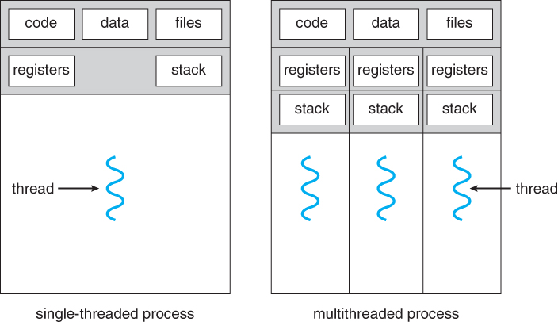
Thread Model

Slide 5
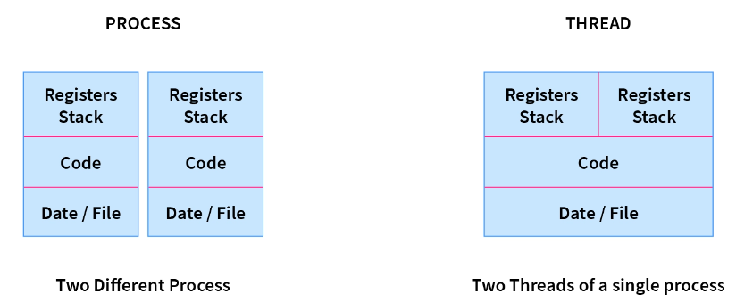
Process:
Ex: Opening two different browsers.
Thread:
Ex: Opening two tabs in the same browser.

Slide 6
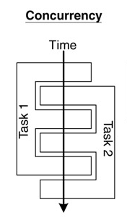
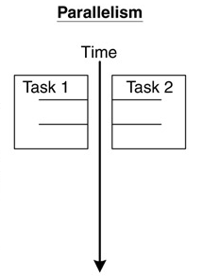
Concurrency and Parallelism
Concurrent multithreading systems give the appearance of several tasks executing at once, but in actuality, the threads do transition back & forth to give a multitasking illusion.
In Multithreading, context switching is possible by using scheduling algorithms or some interrupt.
In parallel systems, two tasks are actually performed simultaneously. Parallelism requires a multi-CPU system.

Slide 7
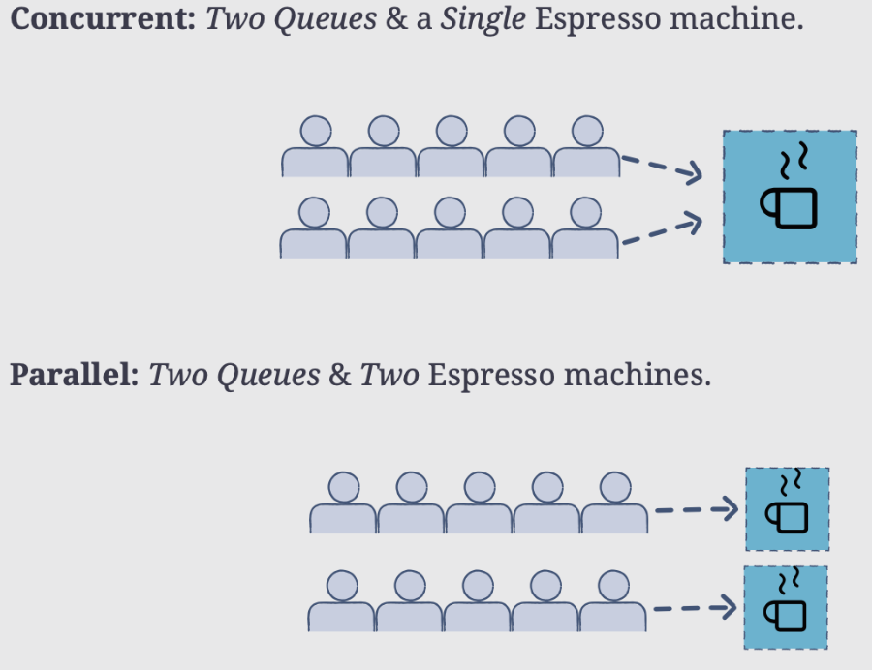
Concurrency and Parallelism

Slide 8
Multithreading
A program with multiple threads running within a single instance could be considered a multitasking system within an OS.
In a multithreading program, threads have the following properties:
A thread begins execution at a predefined, well-known location. For one of the threads in the program, that location is the main() method; for the rest of the threads, it is a particular location the programmer decides on when the code is written.
A thread executes code in an ordered, predefined sequence.
A thread executes its code independently of the other threads unless there is no shared resource required.
The threads appear to have a certain degree of simultaneous execution.

Slide 9
Synchronization
Background
Concurrent access to shared data may result in data inconsistency.
Maintaining data consistency requires mechanisms to ensure the orderly execution of cooperating processes (or threads).
When do we need synchronization?
When two or more processes (or threads) work on the same data simultaneously. There is the possibility of dirty reading or dirty writing that may cause Race conditions.
If multiple threads access shared data and are not synchronized with each other, we can face situations wherein the threads processing the shared data generate different results every time.
Ex: Bank Account deposits from 2 different Apps simultaneously may give different o/p if they aren’t properly synchronized.

Slide 10
Synchronization
Example:
Two threads are trying to update the same shared variable simultaneously:
The result is unpredictable.
The result depends on which of the two threads was the last one to change the value.
The competition of the threads for the variable is called a race condition.
The first thread is the one that wins the race to update the variable.

Slide 11
Classical Synchronization Problems
Bounded buffer (Producer-Consumer problem):
A pool of n size.
Producer processes put items into the pool.
Consumers take items out of the pool & consume them.
There must be synchronisation between producers to avoid conflict.
So, the rate of producer & consumer should be synchronized else they would not complete the task in the stipulated time(RR).
Bounded buffer

Slide 12
Classical Synchronization Problems
Readers-Writers
Multiple processes access a shared data object X.
Any number of readers can access X at the same time.
No two writer-writer & reader-writer can access shared data X at the same time.
So, for the writer we want mutual exclusive access.
Ex: Access a file in Reader or Writer mode by more than one thread. (IRCRTC)

Slide 13
The Critical Section Problem
Definition:
A critical section is a piece of code that accesses a shared resource (data structure or device) that must not be accessed by more than one thread of execution at the same time.
Conditions:
n threads all competing to use some shared data.
Each process has a code segment, called the critical section, in which the shared data is accessed.
Problem: How to ensure that when one process is executing in its critical section, no other process is allowed to execute in its critical section?

Slide 14
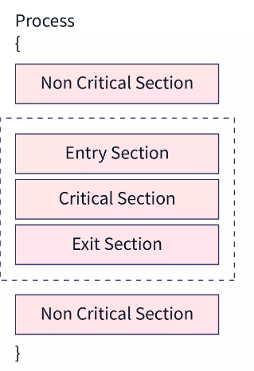
The Critical Section Problem
Solution – three requirements:
If a process enters the critical section, then no other process should be allowed to enter the critical section. This is called mutual exclusion.
Progress means that if a process is not using the critical section, then it should not stop any other process from accessing it. In other words, any process can enter a critical section if it is free.
If a process wants to enter into the critical section, then there should be a specified time that the process can be made to wait. This property is called bounded waiting.

Slide 15
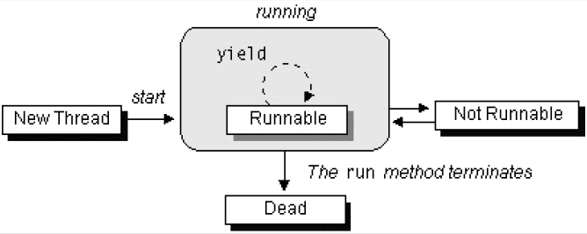
The Lifecycle of a Thread
The start( ) method creates the system resources necessary to run the thread, schedules the thread to run, and calls the thread's run( ) method.
A thread becomes Not Runnable when one of these events occurs:
If sleep( ) method is invoked.
The thread calls the wait( ) method.
The thread is blocked on I/O operations.
The thread dies naturally when the run( ) method exits.

Slide 16
Synchronization Mechanism in Multithreading
There are several ways to control access to the shared resource like-
Mutex,
Semaphores,
Conditional variable.

Slide 17
Posix thread V/s C++ Thread Class
 | POSIX Thread | C++ Thread Class
1. | POSIX threads support almost all platforms. It supports both C++/C both languages. | But, if you only use Linux/Gcc std::thread is perfectly fine.
2. | POSIX thread is a fundamental library in itself. | But, the C++ Thread class is implemented over the top of the POSIX library.
3. | It is written using procedural language. | std::thread provides abstraction as it is a class & has good interface.
4. | It predominantly supports both C++/C both languages. | C++ thread Class was introduced in C++11.
5. | POSIX Thread functions(Cond_var, Mutex_Lock, Semaphors) we’ll discuss here in our PPT. | C++ thread class has more features.
6. | Here we don’t have dynamic features as a C++ thread class(that smoothly handles Asynchronous apps). | It is updating continuously as we got reader/writer lock in C++14, timed_mutex_lock in C++17 & (std::promises & std::future class in C++20).

Slide 18
std::thread Functions
Create a thread: used to create a new thread.
std::thread th(fun, args);
Pass arg by ref( ): is used to pass args by reference.
std::thread th(fun, std::ref(args));
Thread_Joinable( ): function returns a bool value, if the thread is Joinable(Active) it returns true else false.
std::thread::joinable( );
Thread Join: function used to wait for a thread to finish. std::join(thread th);
Thread_id( ): used to get the thread id of the thread.
std::this_thread::get_id( );

Slide 19
std::thread Functions
Thread_detach( ): used to detach a thread. A detached thread does not require a thread to join on terminating. The resources of the thread are automatically released after termination if the thread is detached.
std::thread::detach( );
Thread move( ): function handover the task of a particular threadA to another threadB & the threadA no longer remains a thread.
std::thread th(fun, std::ref(args)) ; thread th1(std::move(th)) ;
Thread_sleep_for( ): used to Block the execution of the current thread for the intended time.
std::this_thread::sleep_for(std::chrono::milliseconds(n));
Thread_sleep_until( ): function suspends the execution of the thread until a specified time has elapsed.
std::sleep_until( const std::chrono::time_point<Clock, Duration>& sleep_time );

Slide 20
Synchronization Mechanisms
Mutex
Condition Variable
Semaphores

Slide 21
Mutex
A Mutex is a lock that we set before using a shared resource and release after using it.
When the lock is set, no other thread can access the locked region of the code.
So, we see that even if thread 2 is scheduled while thread 1 was not done accessing the shared resource and the code is locked by thread 1 using mutexes, thread 2 cannot even access that region of code.
Mutex objects: are of two types :
Syntax: std::mutex mtx ;
Syntax: std::timed_mutex mtx ; // used with time-based locking technique
Mutex Locking & Unlocking: is done using the following member functions:
std::mutex::lock: is used to apply a lock on a mutex object.
std::mutex::try_lock: tries to lock a mutex object. It returns a bool value, true if the lock is acquired successfully else false.
std::mutex::unlock: is used to unlock a mutex object.

Slide 22
Mutex
std::lock_guard<mutex>: acquires the mutex lock the moment you create it & automatically removes the lock while goes out of scope. No need to explicitly unlock it.
std::unique_lock<mutex>: is the same as the above one but it’s not restrictive as lock_guard, it can be created without immediately locking.
std::try_lock: tries to lock a mutex object. It immediately returns a bool value, true if the lock is acquired successfully else false.
Note: Both below functions are applicable on only std::timed_mutex.
std::try_lock_for(t): tries to lock for the timeout time & returns a bool value, true if the lock is acquired successfully else false.
std::try_lock_until(t): tries to lock till a specified amount of time & returns a bool value, true if the lock is acquired successfully else false.

Slide 23
Condition Variable
Condition variables allow the implementation of powerful and efficient synchronization mechanisms. That allows the Conditional variable to exchange signals among threads.
It blocks other threads until another thread modifies the shared variable & notifies the condition variable.
The principle of the Condition variable is signal & wait.
Condition Variable: object can be created using the below :
Syntax: std::condition_variable cdv ;
Member function(wait): (Giving Predicate is optional)
std::condition_variable::wait(lock): blocks the thread until notified.
std::condition_variable:: wait_for(lock, timeout): wait for timeout or until notified within the timeout.
std::condition_variable:: wait_until(lock, timepoint ): wait until notified or a point of time occur.
Member function(notify):
notify_one( ): It notifies only one of the thread.
notify_all( ): It notifies all the thread.

Slide 24
Semaphore
A semaphore is an integer variable, shared among multiple processes. The main aim of using a semaphore is process synchronization and access control for a common resource in a concurrent environment.
Kind of semaphore: a) Counting Semaphore, b) Binary Semaphore.
Binary Semaphore: used to solve the Critical section problem of mutual exclusion.
Syntax: std::counting_semaphore<int num> sem;
Counting Semaphore: used to solve the resource allocation problem(H).
Note: binary_semaphore = std::counting_semaphore<1> ; // both are equivalent
Member functions: (cpp.sh)
std::counting_semaphore::release( ): increments the internal counter and unblocks acquirers.
std::counting_semaphore::acquire( ): decrements the internal counter or blocks until it can.

Slide 25
std::counting_semaphore::try_acquire( ): returns a bool value & tries to decrement the internal counter without blocking if it acquires successfully then True else False.
std::counting_semaphore::try_acquire_for( ): tries to decrement the internal counter, blocking for up to a duration time if it acquires successfully then True else False.
std::counting_semaphore::try_acquire_until( ): tries to decrement the internal counter, blocking until a point in time if it acquires successfully then True else False.

Slide 26
Asynchronous Programming
The Program initiates the operation and then registers a callback that will be invoked when the results are available. Not having to wait for completion means you can do useful work while the operation is in progress—service the message loop or start other asynchronous operations.
To launch an asynchronous task we use the std::async function, which returns an object of < future >.
An asynchronous task doesn’t immediately need a result. If we wanted to use std::thread to develop such Apps, we should be aware of the fact that std::thread does not provide an easy way to return a value from a thread.
We could get the return value of the tasks | functions via references, variable pointers or global variables but these approaches share data between multiple threads and look a bit cumbersome.
There are 2 ways in which the std::async function can be used:
Without specifying the policy: the system chooses any launch policy:
syntax: std::future<type> fut = std::async(fun, args) ;
2. Specifying the policy: here we explicitly specify any of the policy launch::deferred or launch::async :
syntax: std::future<type> fut = std::async(launch::async / deferred , fun, args) ;
launch::deferred will invoke the function on the calling thread,
launch::async will invoke the function on a new thread.
launch::any will invoke any of the above launch policies.

Slide 27
std::future<int> futureObj:
std::future is a class template, its object internally stores a value that will be assigned in future and it also provides a mechanism to access that value i.e. using the get() member function.
If somebody tries to access this associated value of future through get() function before it is available, then the get() function will block till the value is not available.
Syntax: std::future<int> futureObj ;
std::promise<int> promiseObj:
std::promise is also a class template and its object promises to set the value in future. Each std::promise object has an associated std::future object that will give the value once set by the std::promise object.
std::promise provides a facility to store a value that is later acquired asynchronously via a std::future object created by the std::promise object
A std::promise object shares data with its associated std::future object.
Syntax: std::promise<int> promiseObj ;

Slide 28
future & Promise
Suppose Thread-1 creates a std::promise object and passed it to the Thread-2 object.
Syntax: std::promise<int> promiseObj;
Now, we want Thread-1 to know when Thread-2 is about to set the value in the corresponding std::promise object. To achieve this we use the std::future object.
std::promise object has an associated std::future object, through which others can fetch the value set by promise.
Thread-1 will create the std::promise object and then fetch the std::future object from it before passing the std::promise object to Thread-2 i.e.
Syntax: std::future<int> futureObj = promiseObj.get_future();
Thread-1 will pass the promiseObj to Thread-2. Then, Thread-1 will fetch the value set by Thread-2 in std::promise through std::future’s get() function,
int res = futureObj.get();
But, if the value is not yet yielded by Thread-2 then this call will get blocked until Thread-2 sets the value in the promise object i.e.
promiseObj.set_value(value);

Slide 29
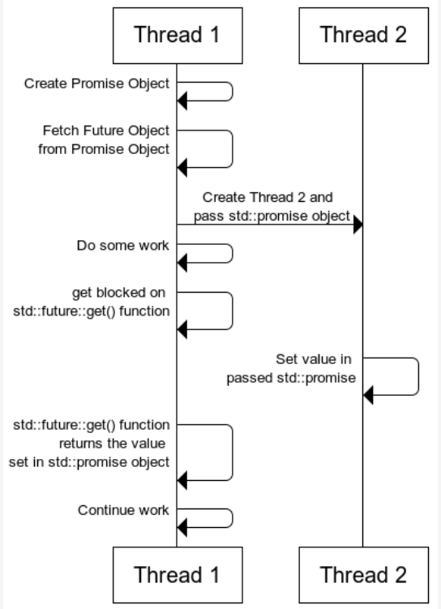
Promise & Future Workflow

